Slide 1
Activ Client 6.2 Home Version
Sgt Gandiafuret
TBS S6

Slide 2
What is ActivClient?
ActivClient is the main DoD CAC software. ActivClient is the smart card middleware from ActivIdentity that allows government organizations to easily use smart cards and USB tokens for a wide variety of desktop, network security and productivity applications.

Slide 3
ActivClient?
How to install Activ Client 6.2 Home Version

Slide 4
Notes:
Windows 8 and Windows 10 Users, click the Start button and click on the Internet Explorer icon.

Slide 5
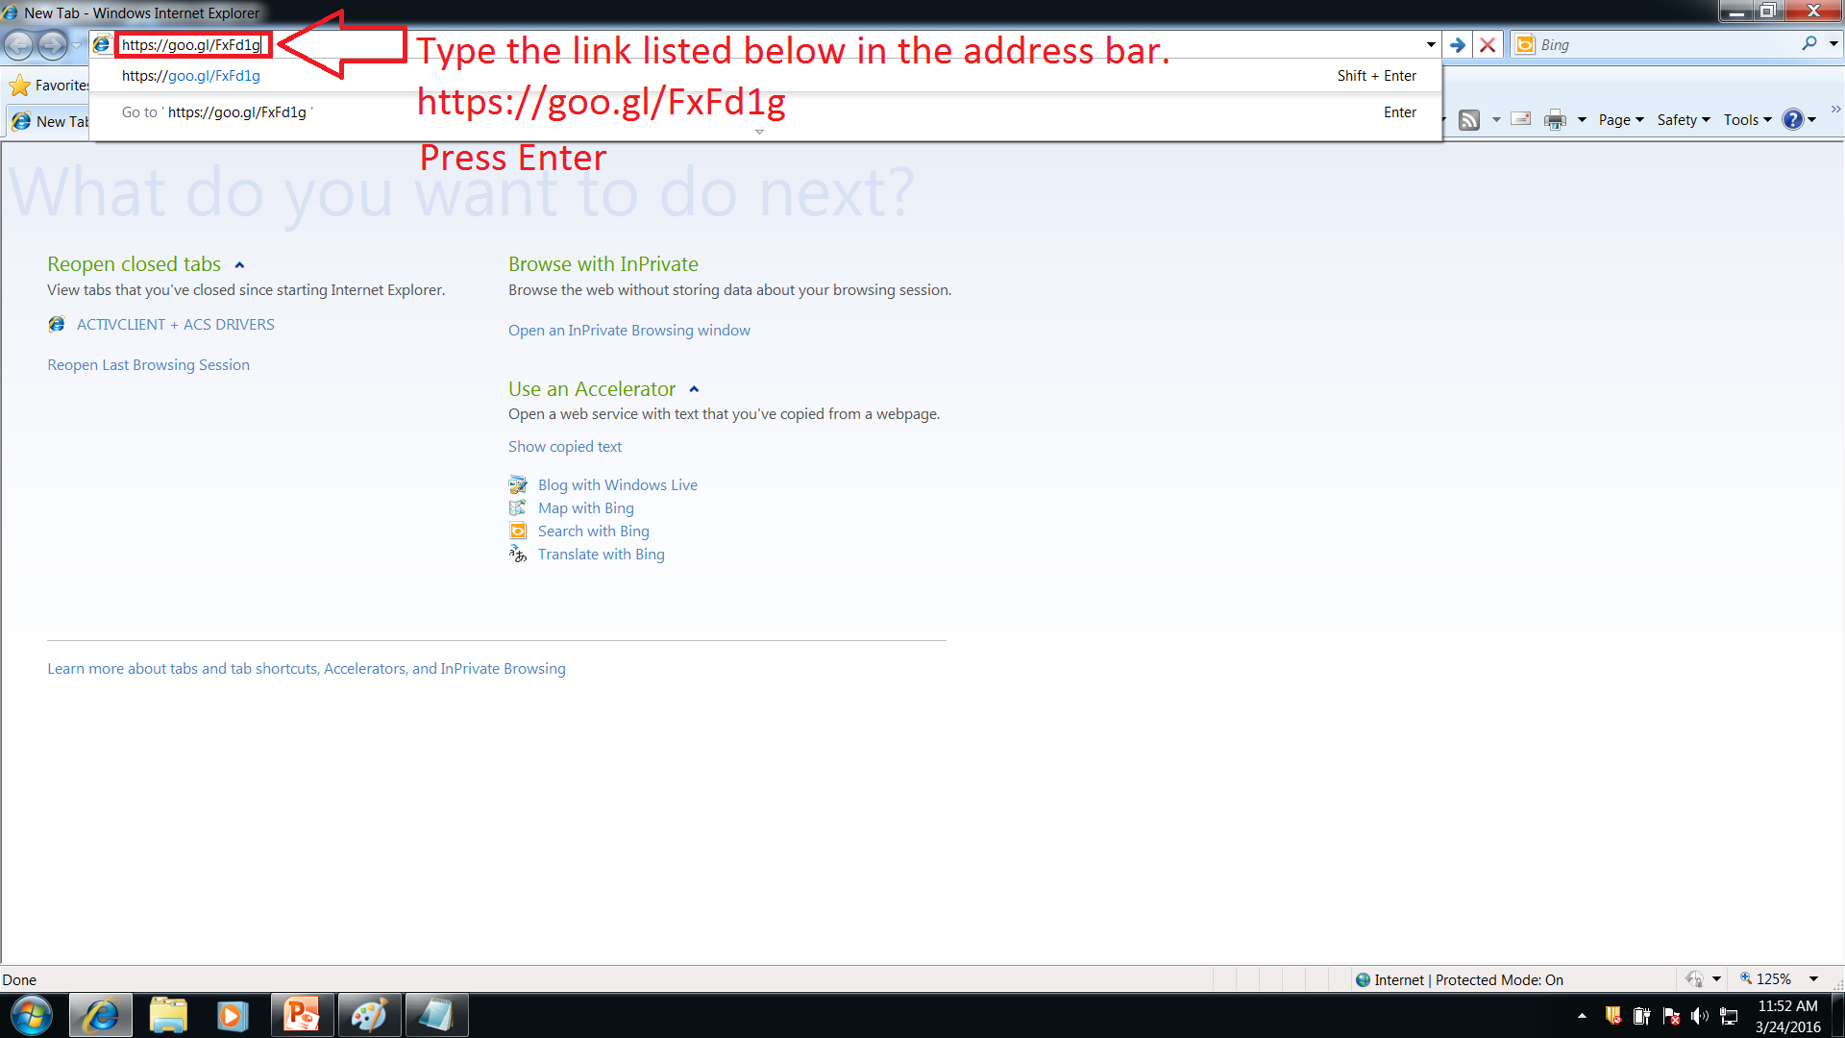

Slide 6
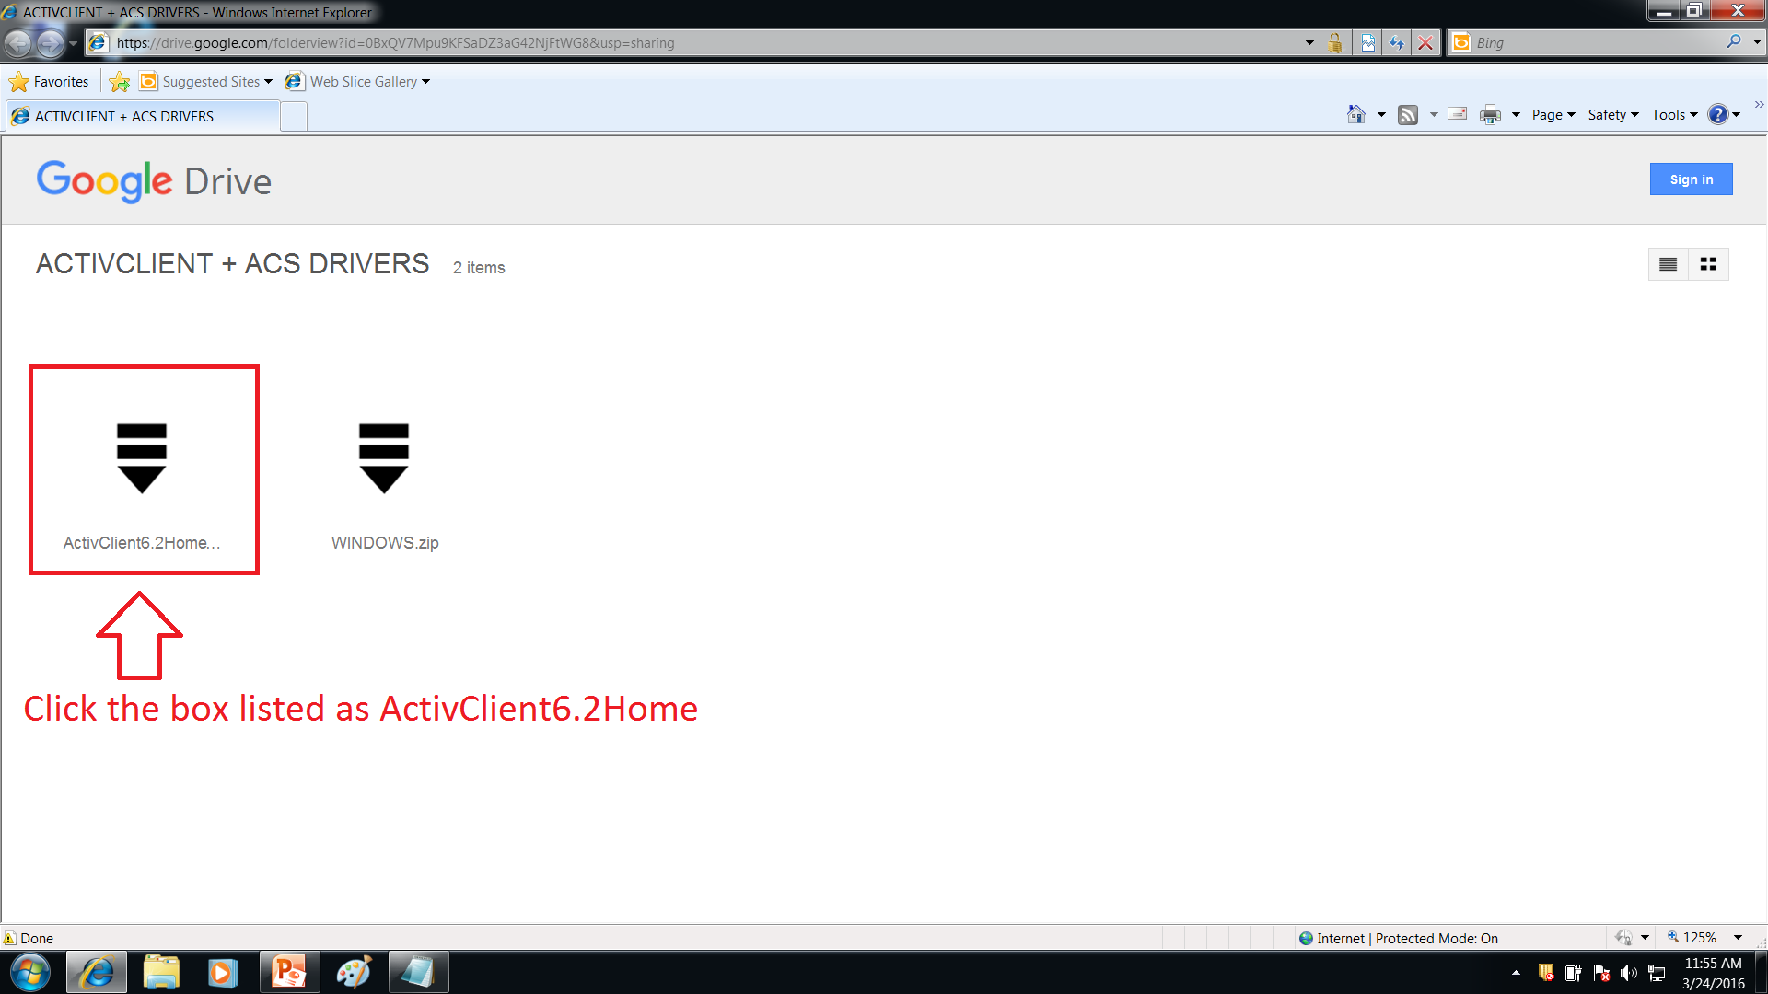

Slide 7
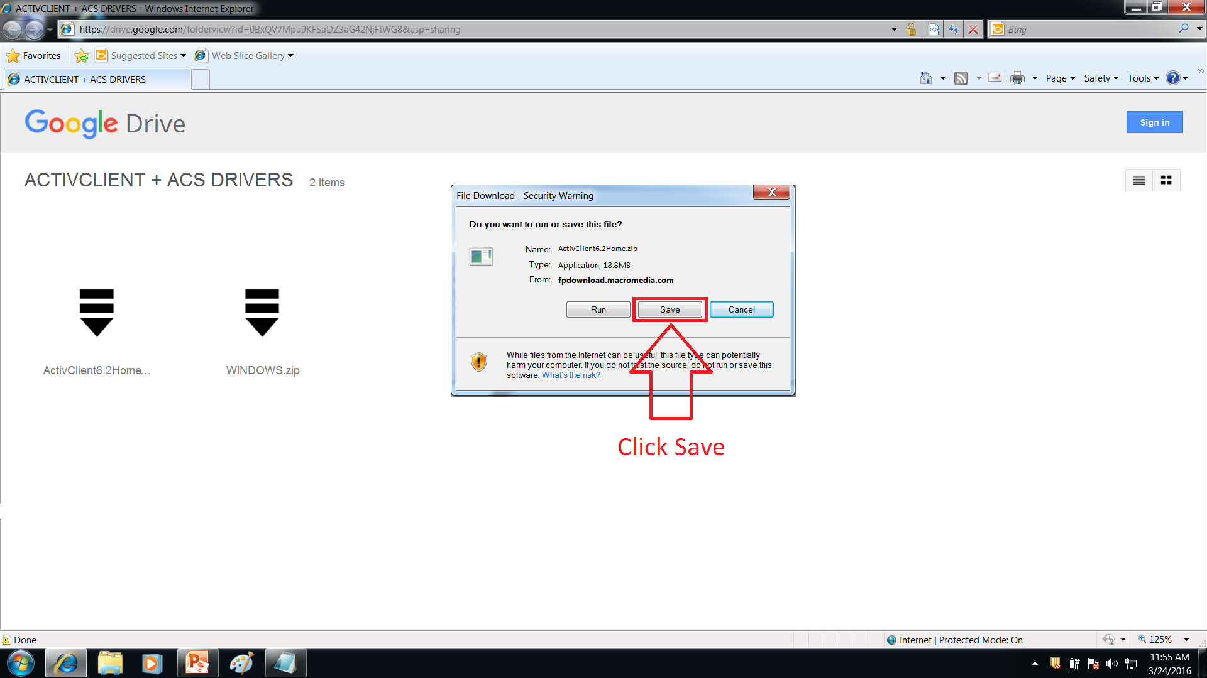

Slide 8
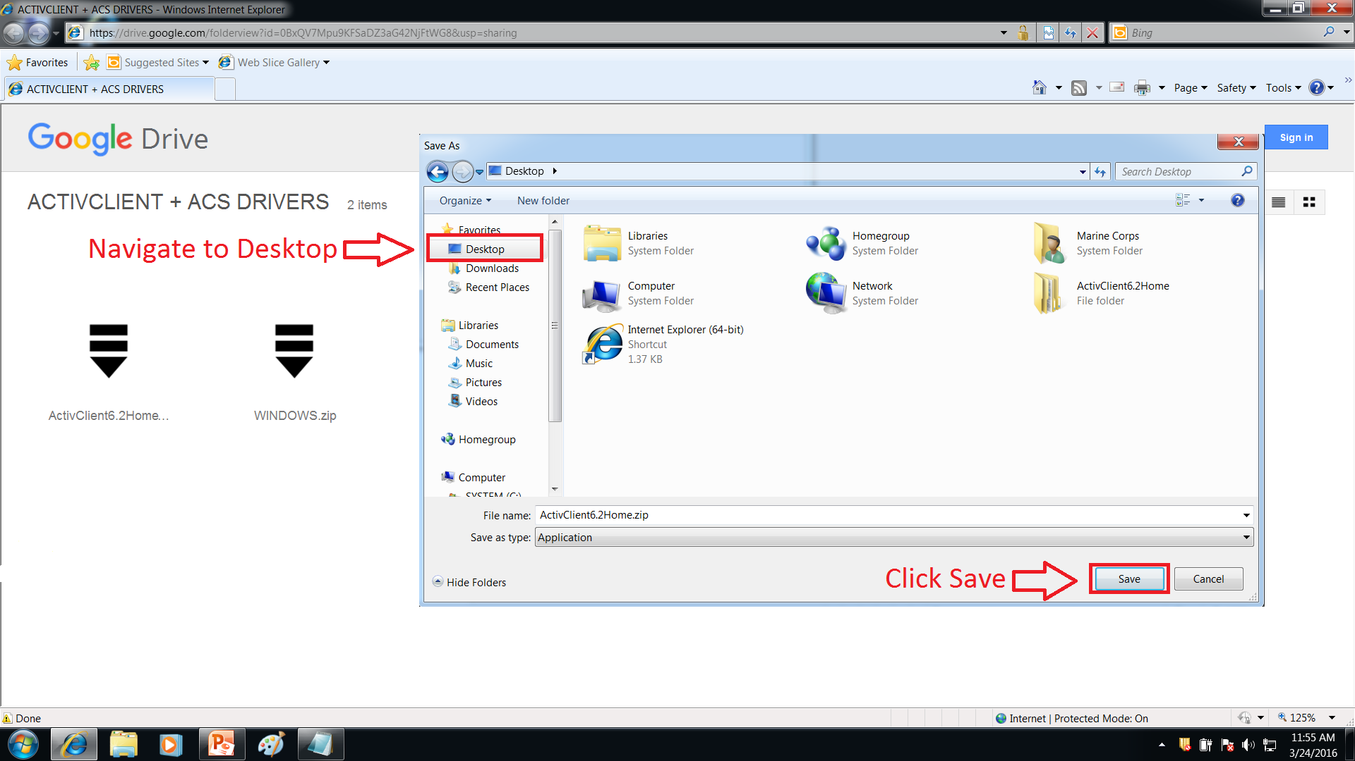

Slide 10
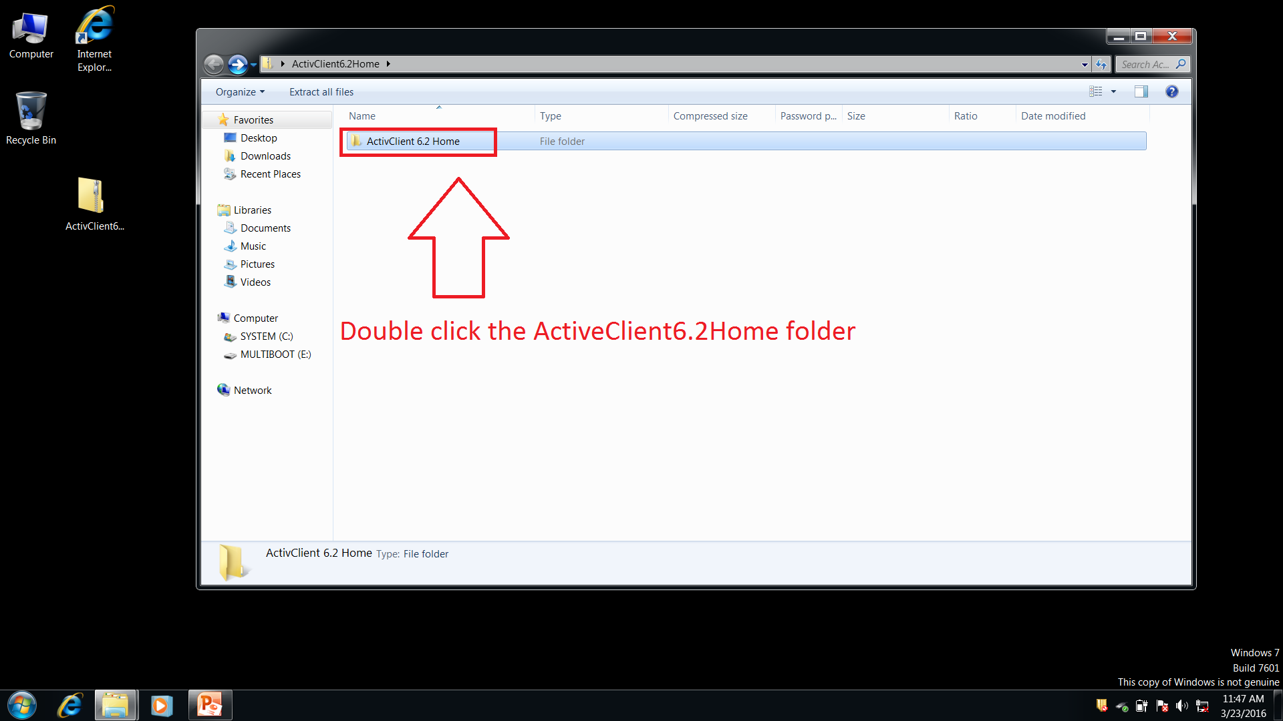

Slide 11
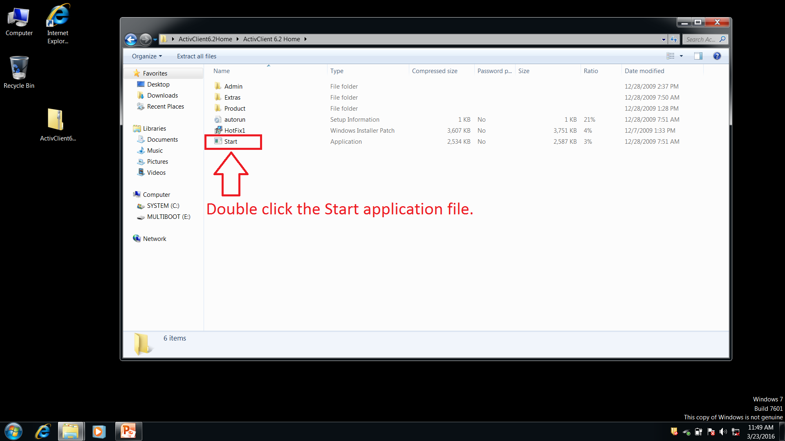

Slide 12
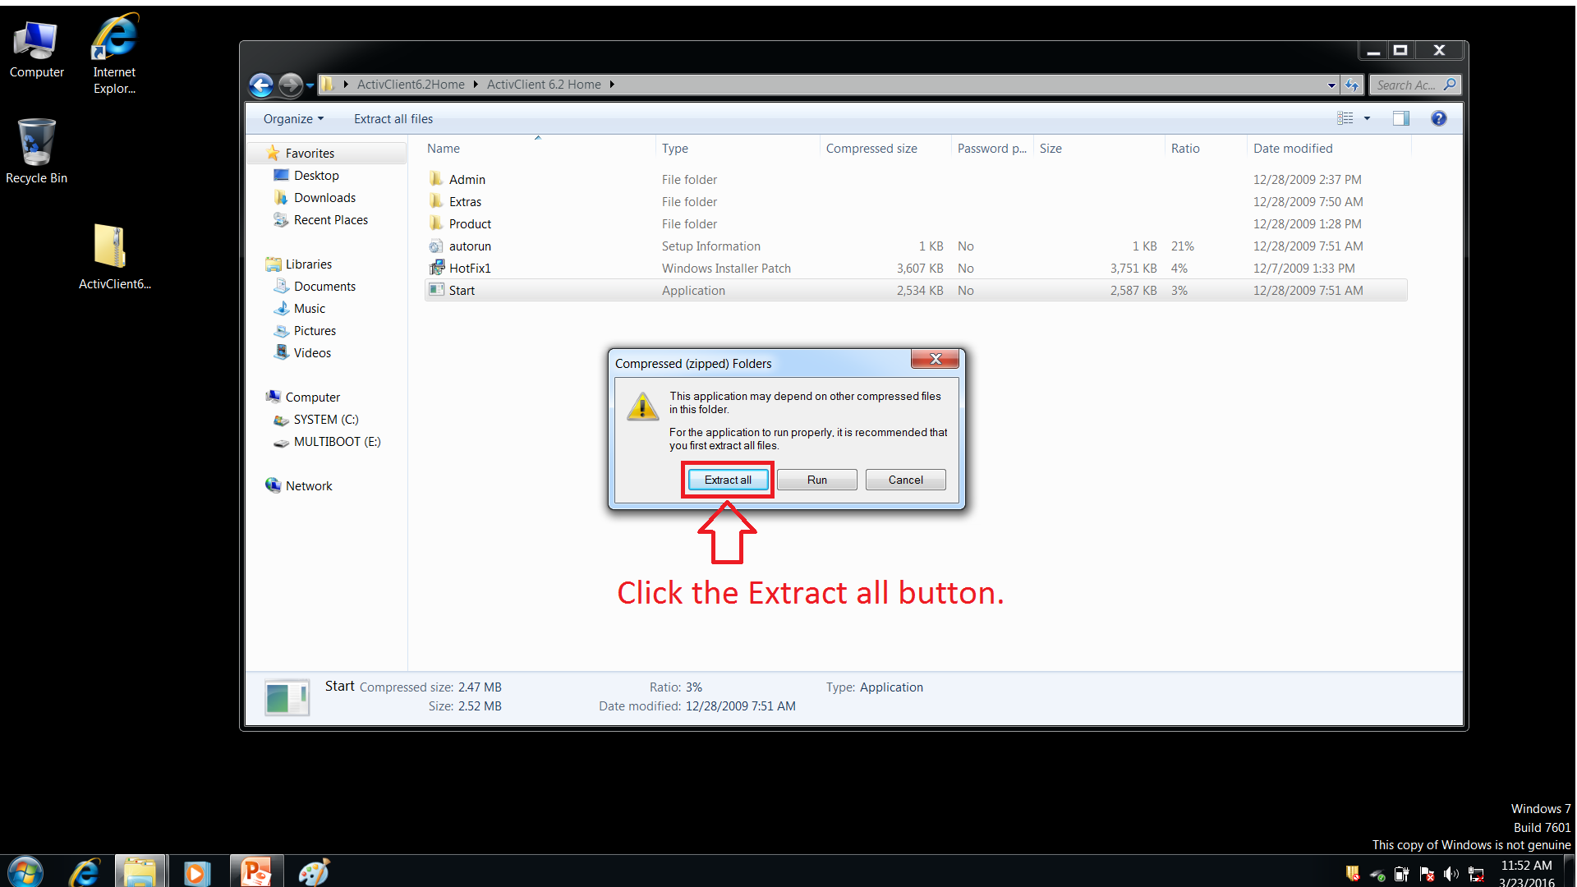

Slide 13
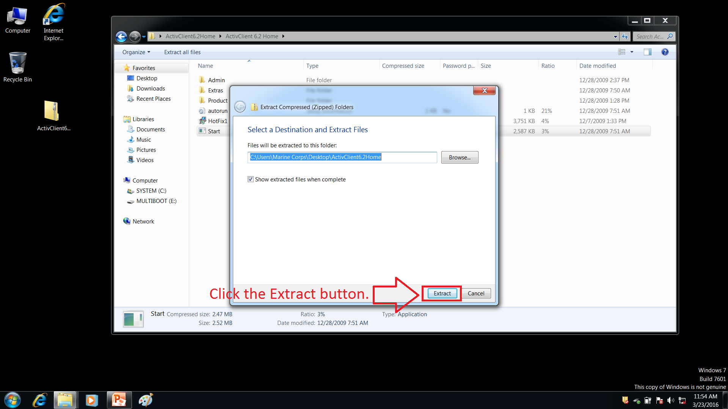

Slide 14
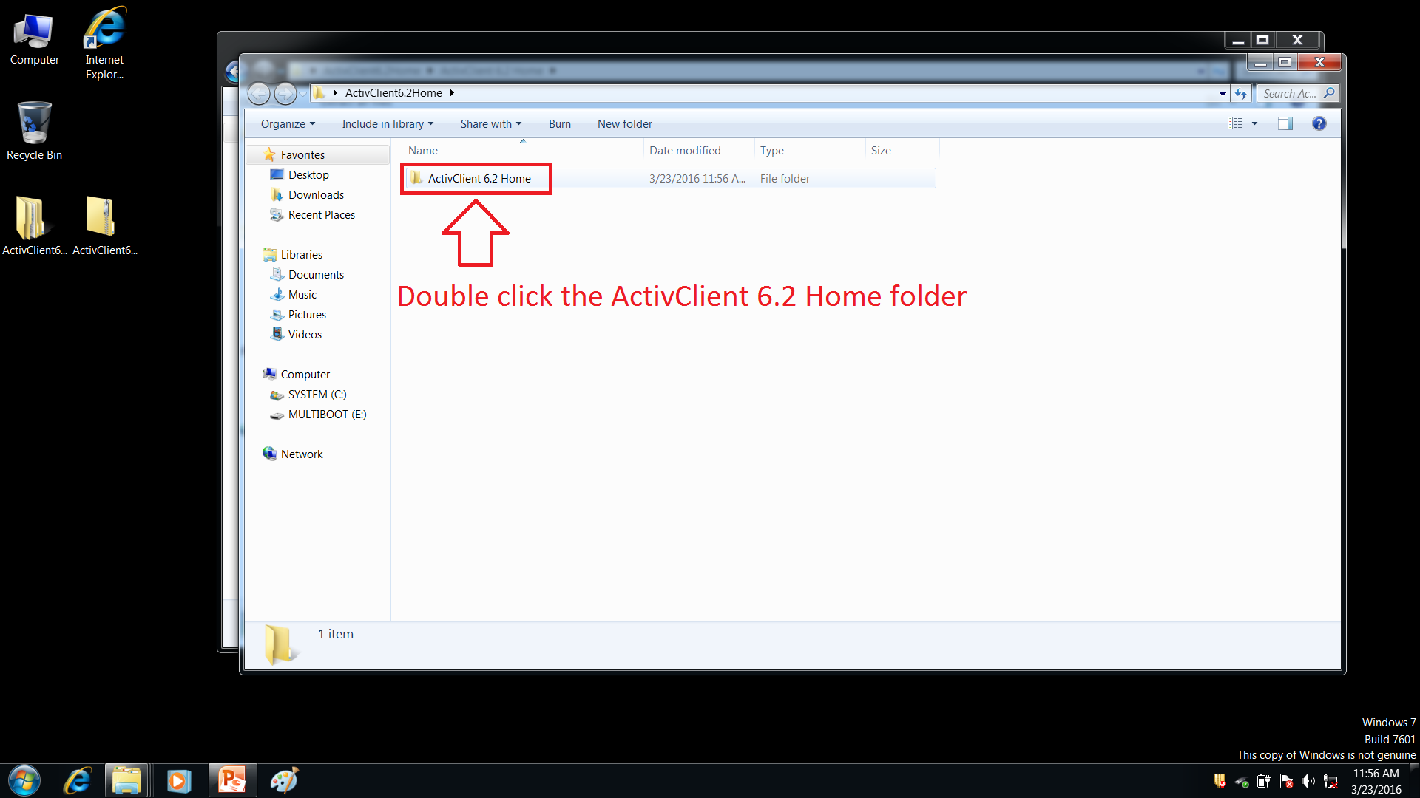

Slide 15
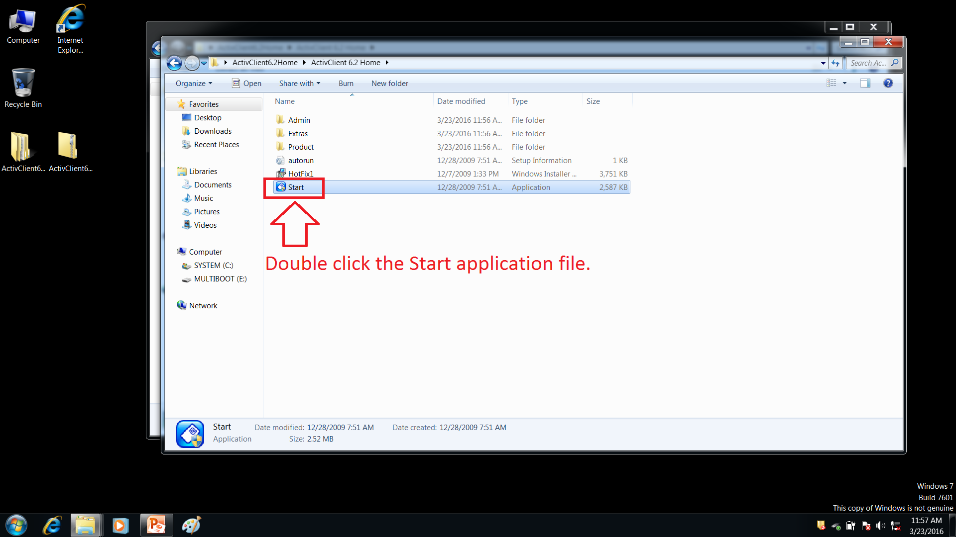

Slide 17
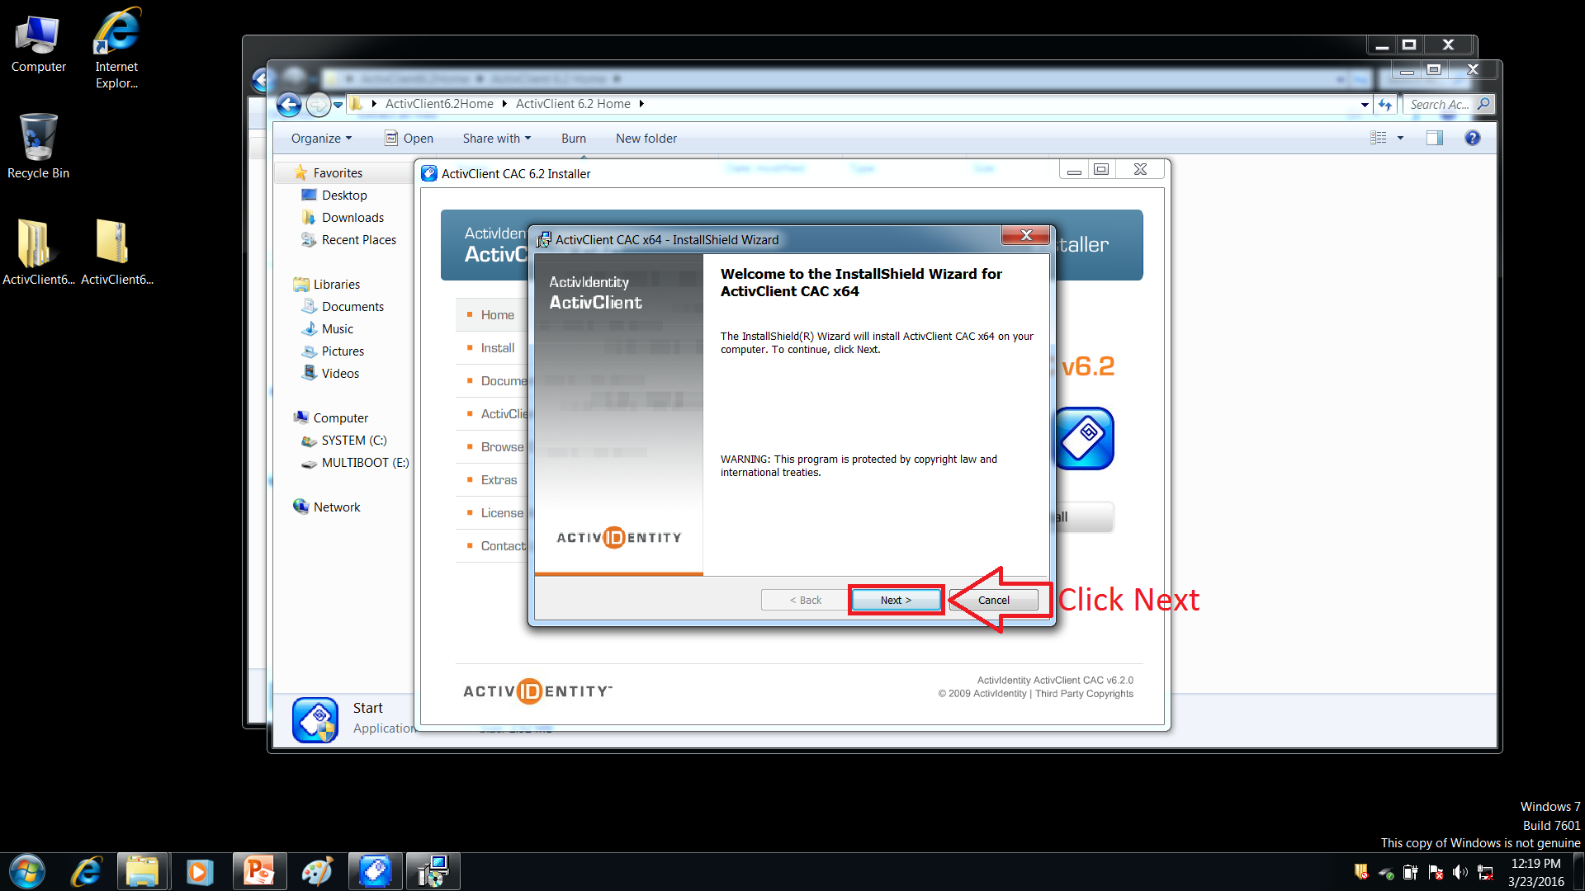

Slide 18
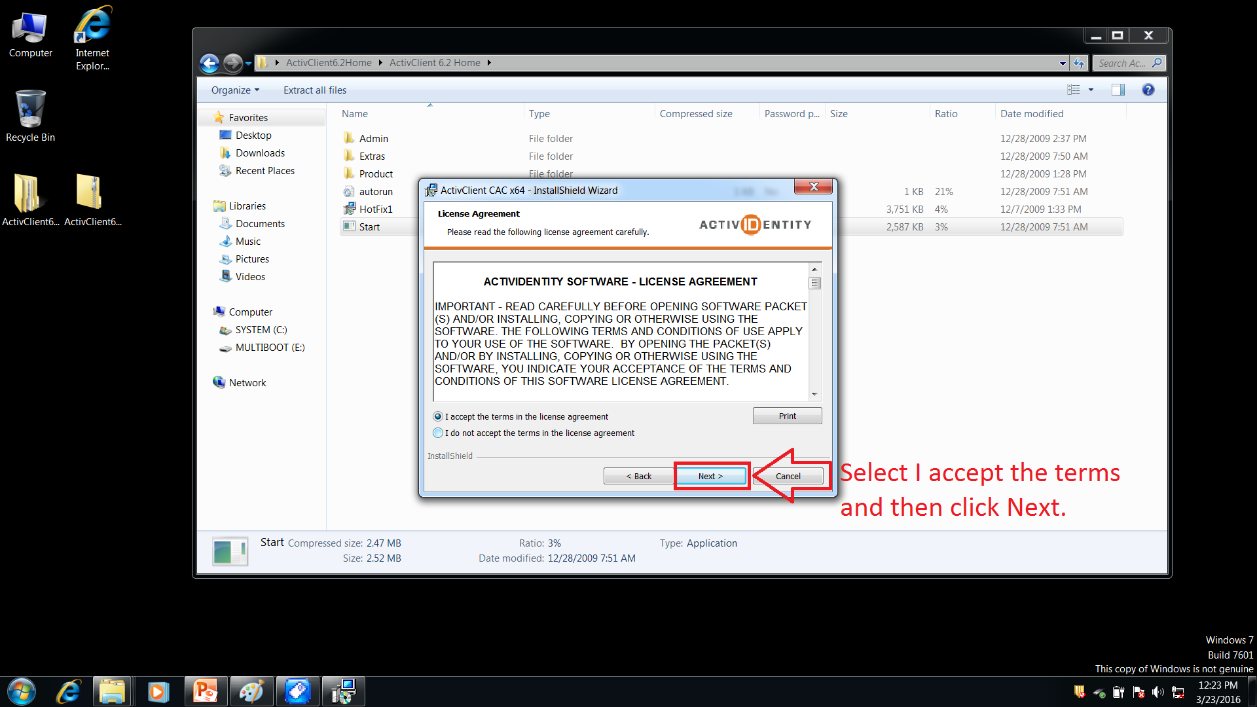

Slide 19
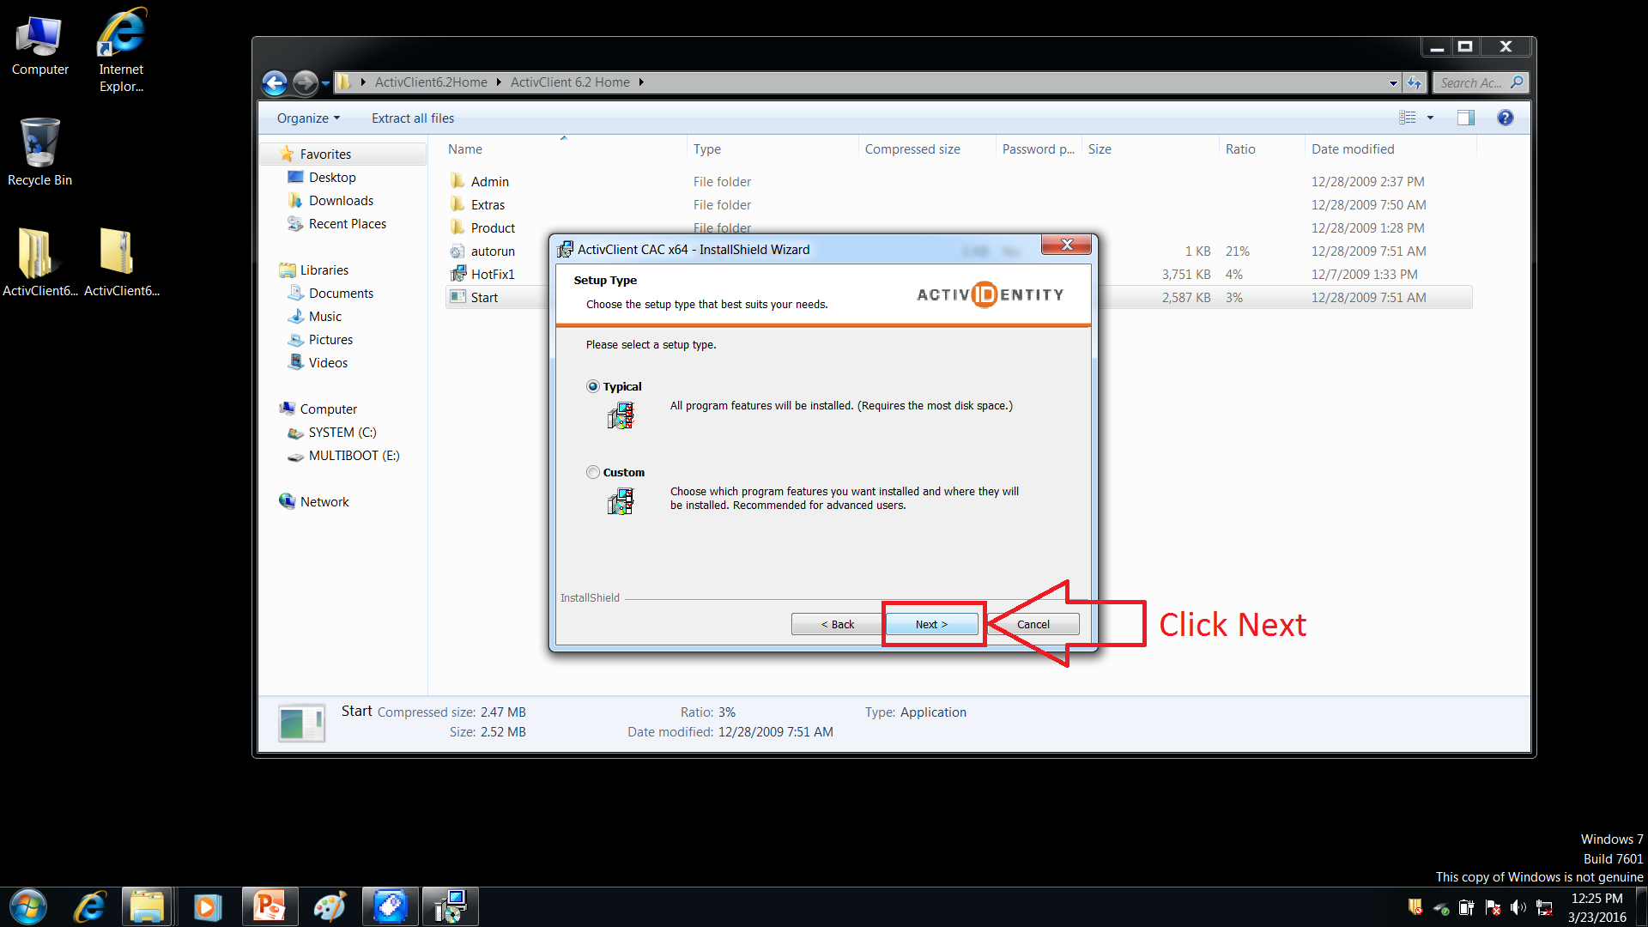

Slide 21
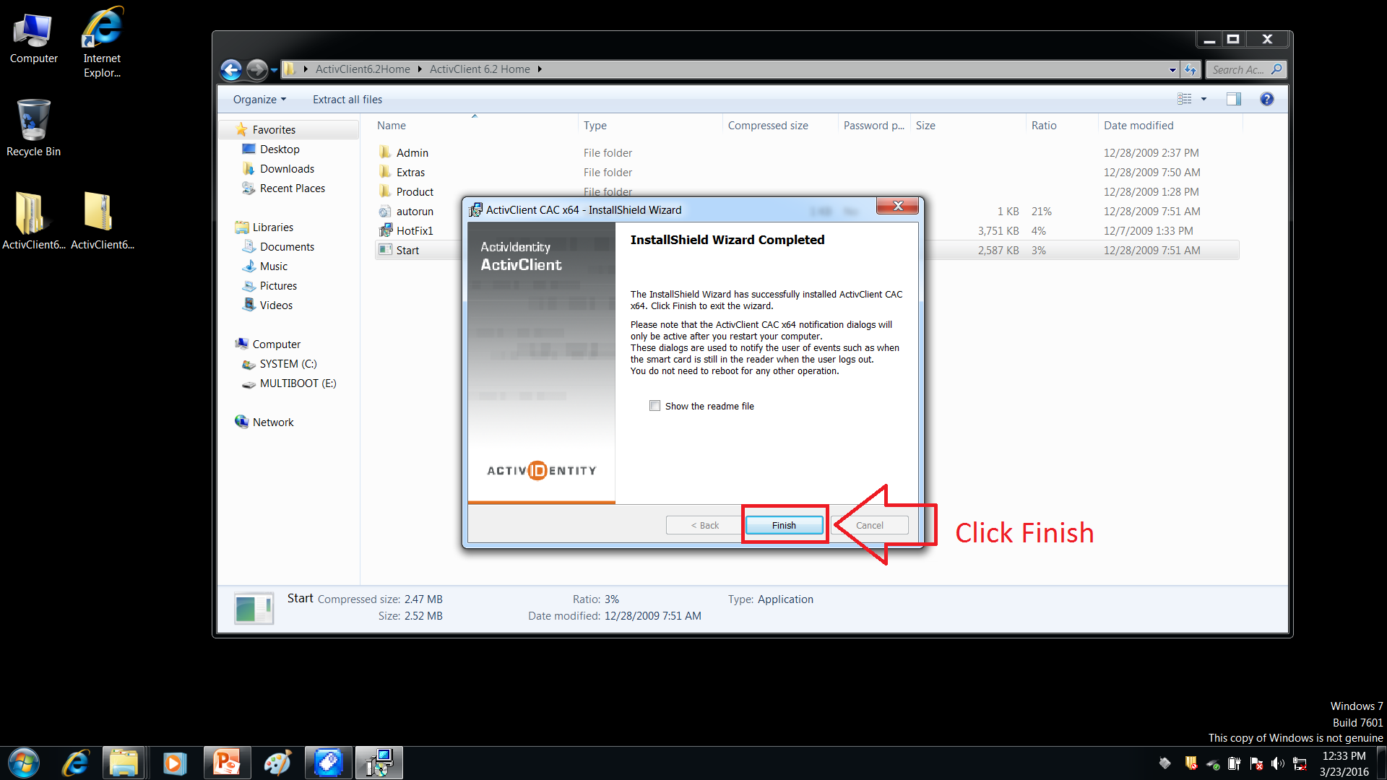

Slide 22
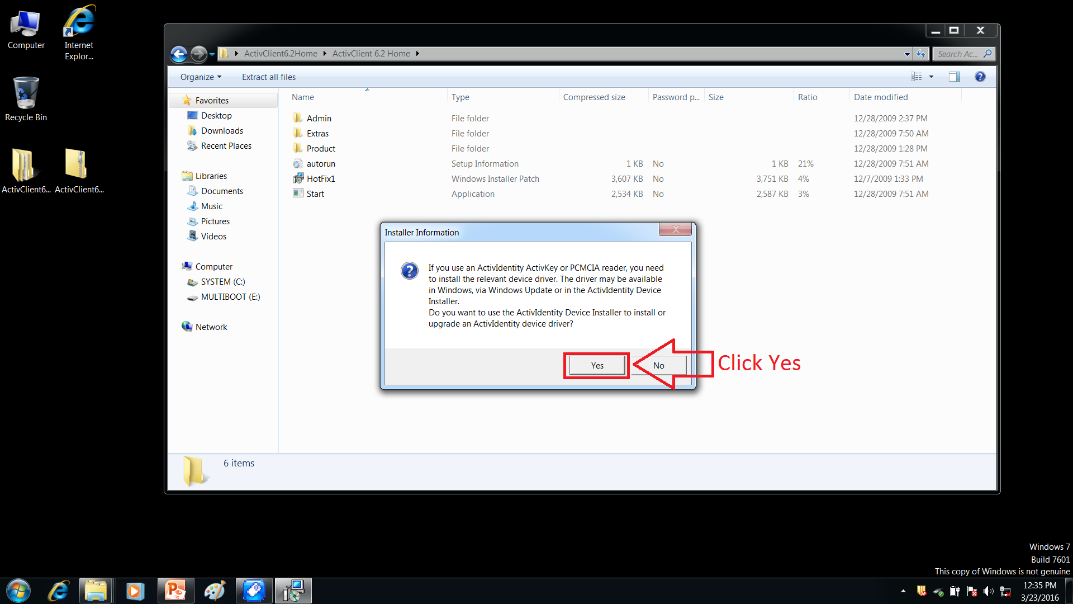

Slide 24
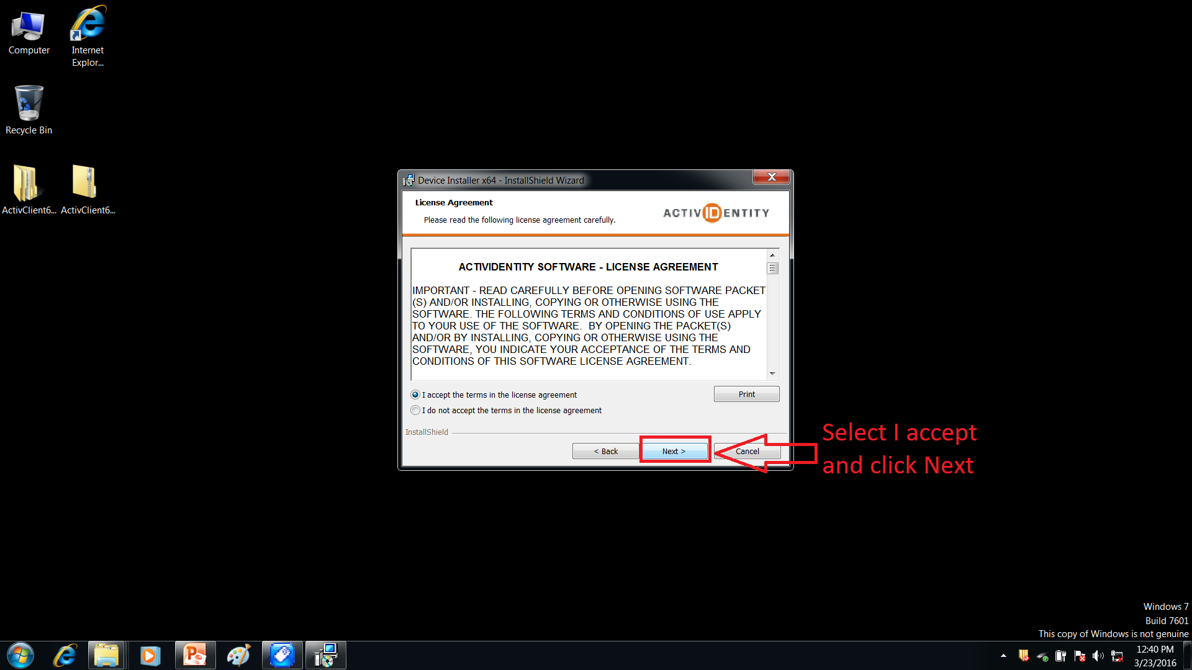

Slide 26
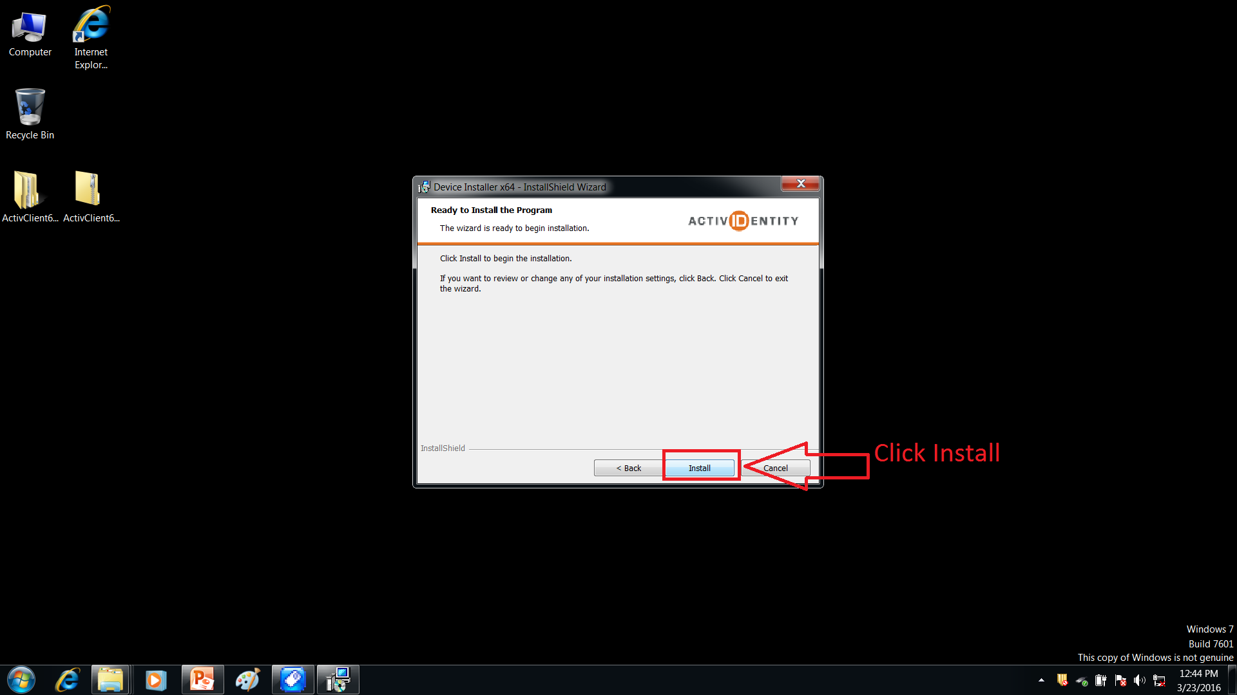

Slide 28
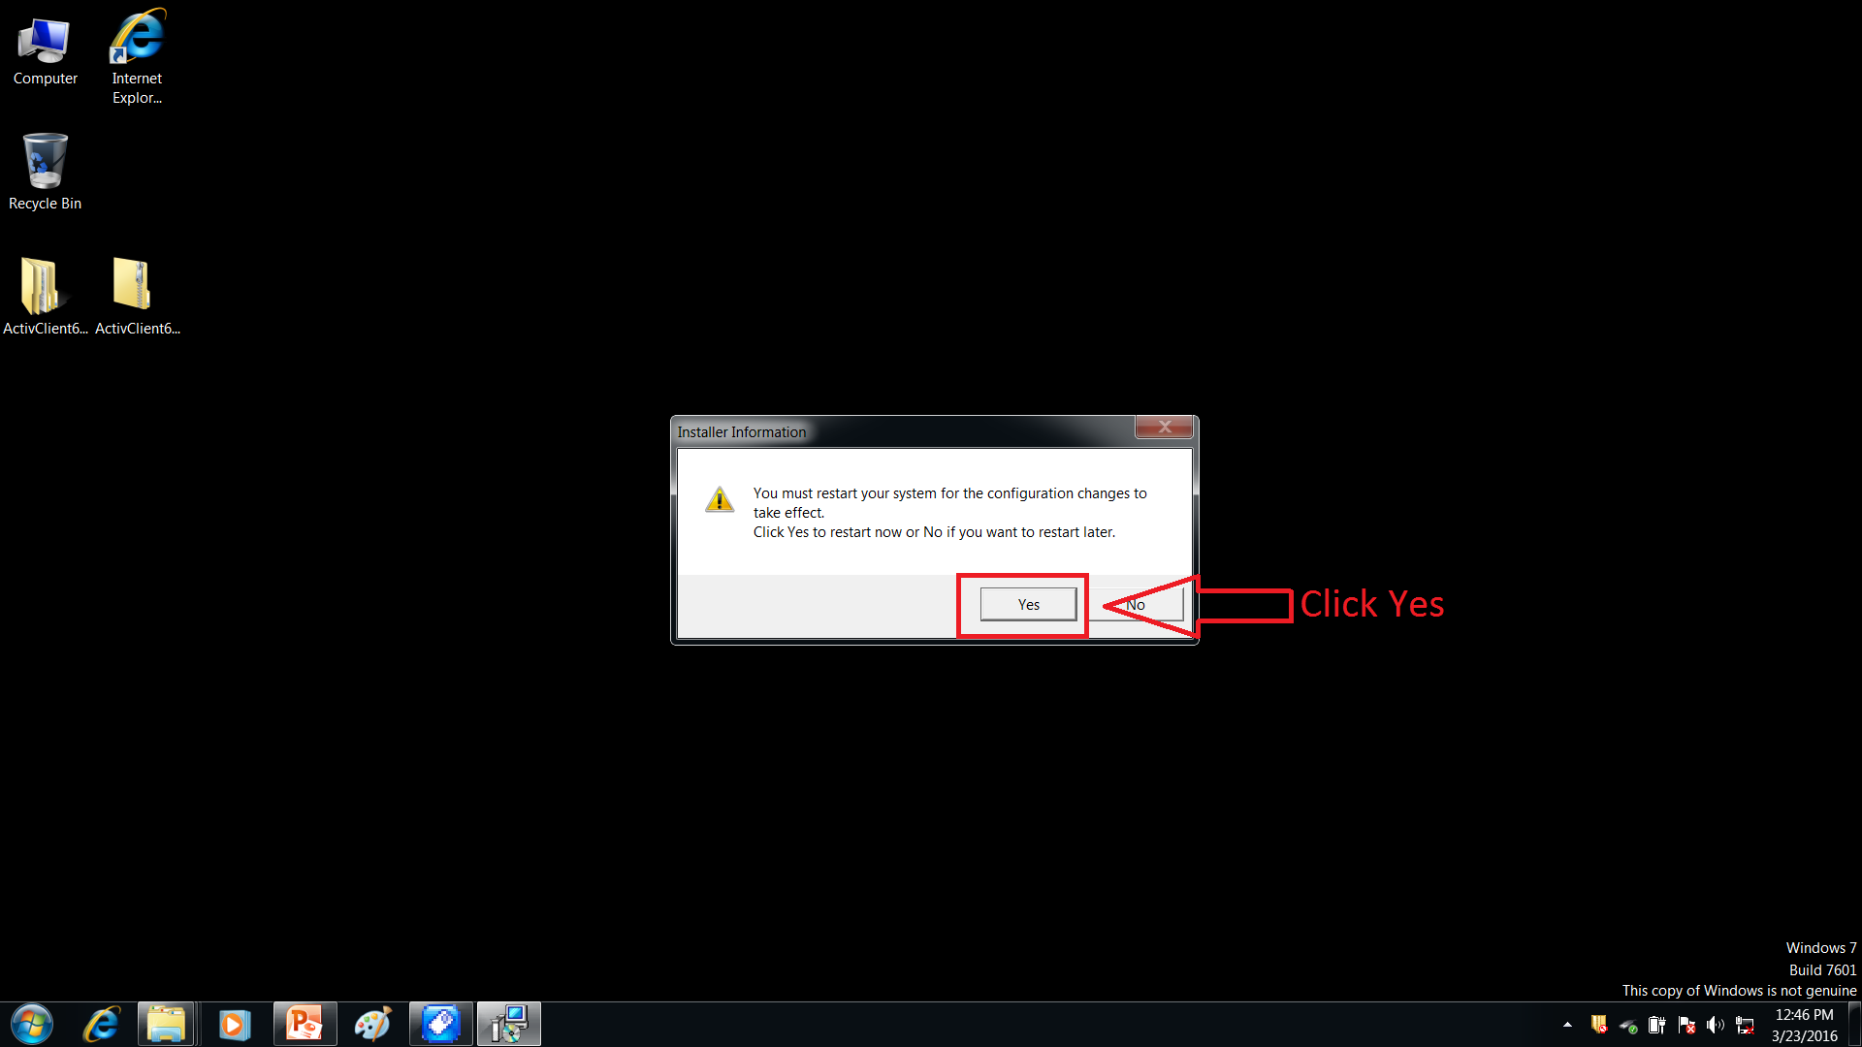

Slide 29
gfjB10yx
gfjB10yx

Slide 30
How to open a TBS Quiz
Once the CAC reader is installed.
Go to https://mctims.usmc.mil
Here the system should prompt you for an access /PIN number to continue to the MCTIMS website, enter your PIN when asked.
Notes:
If you cannot gain access with the provided web address. Try going to http://www.marines.mil/
Once this is open click on the Marines tab, on the left side of the page under the “Training and Education” you will see hyperlink to Marine Corps Information Training Management System (MCTIMS).
Click this link, Here the system should prompt you for an access /PIN number to continue to the MCTIMS website, enter your PIN when asked.

Slide 31
TBS Quiz Continued
If you have never logged into MCTIMS clicking on this link will take you to a new account wizard to confirm your CAC, this will enable your account, and allow you to continue to the testing site.

Slide 32
TBS Quiz Continued
Located Under " Homeport" are several dropdown boxes open the "MCTIMS Resources" and click the "Online Testing" login to QMP. This will open in a new window.

Slide 33
TBS Quiz Continued
Inside Question Mark you will see a Participant Login, enter the Participant ID and Password provided by the company for quizzes.
This will take you to a display that has "Test", "My Details" and "Reports". Select the Test tab.
Displayed are the quizzes you will need to take during the phase. Pay close attention to the closing date as all quizzes close at 0700 the day of the scheduled class, select the quiz you need to complete and follow the instructions.

Slide 34
TBS Quiz Continued
Continue with the quiz and ensure you hit submit prior to closing the browser.
All Quizzes are timed and will timeout if left open once started.
Quiz times are based off of the number of questions, one minute Per question.

Slide 35
TBS Quiz Continued
Once complete please provide any feedback to help us improve this testing method. We ask that you send all feedback to the below individuals.
Capt. Bocian TBS Testing Officer
brandon.bocian@usmc.mil
Mr. Stan Martinez TBS Curriculum Manager
stanley.martinez@usmc.mil

